Slide 1

Foodr
Brayden Chumbley, Olivia Biancucci,
Sarah Toll

Slide 2
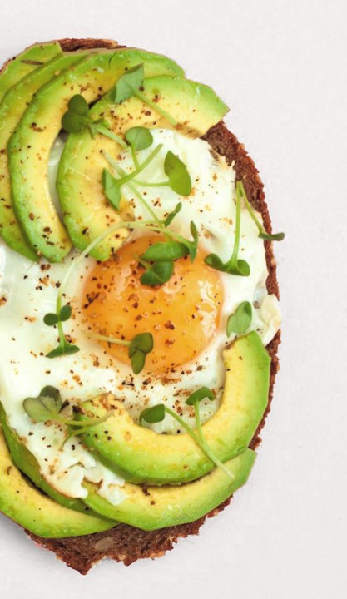
Tell me more about Foodr
5 minutes • Makes 1 application description
WHat is it?
Why build it?
"Tinder" for recipes
Users can build their profile by including information such as their dietary preferences, current ingredients on hand, and preferred amount of prep time
Other features to be discussed on subsequent slides
Help users who are unsure with what to make
Users will save money by ordering out less frequently
Users can know what they can make with their ingredients
Help users with healthy eating habits/dietary restrictions

Slide 3
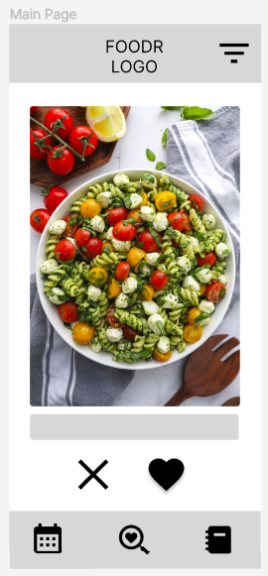
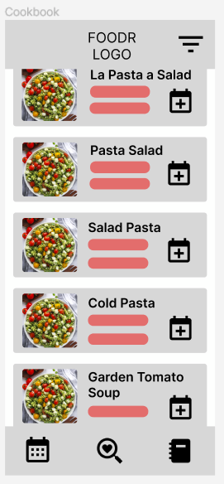
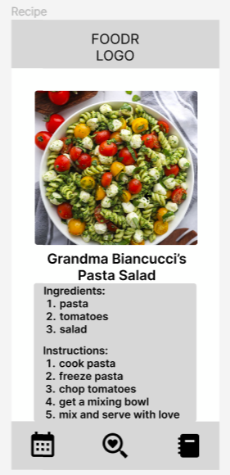
The Initial Design
1 hour • Makes 6 mobile screens
Try with sweet potatoes, zucchini, and bell peppers.
ingredients
Main page
View Cookbook
View Recipe

Slide 4
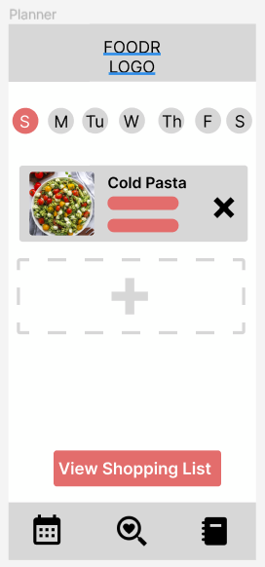
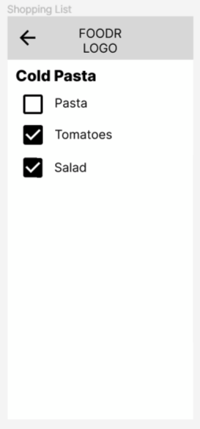
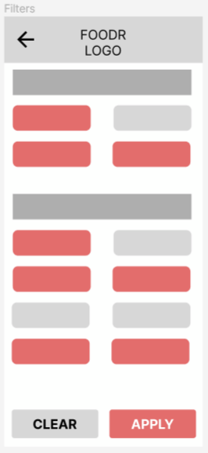
The Initial Design
1 hour • Makes 6 mobile screens
Try with sweet potatoes, zucchini, and bell peppers.
ingredients
Plan Recipes
Shopping List
Filter Recipes

Slide 5
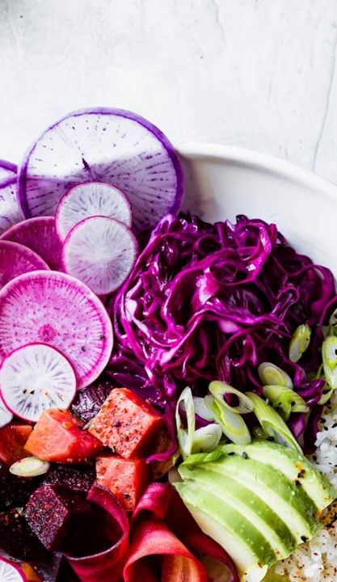
What Sets Foodr Apart
10 minutes • Makes 1 application description
The Competition
What our app brings to the table
Similar application called "Tender" created in 2015
Contained the main "swiping" of recipes and a few smaller features
Has since been removed from the iPhone and Android app stores
Was only available in the U.S.
Had scalability issues as the app increased in popularity
Cross Platform with React Native
Meal-planning and shopping list feature
Blind "date" feature
Personal recipe input (stretch goal)

Slide 6

Our Plan
Project timeline – by week #
30 minutes • Makes 1 mobile app
1: Interface Design
Task priority
Interface Design
Database creation
Swipe to save to cookbook
Viewing the full recipe
Setting preferences
Advanced GOals
Meal planning
Blind date feature
Personal recipe input
2-3: Basic Features
4-5: Database Creation, Advanced Features
6: Stretch Goals, Final Testing

Slide 7

Team Roles
20 minutes • Makes 3 servings
Brayden
Olivia
Sarah
Recipe Page
Filters
Backend API
Planner
Other Advanced Goals
Main Page
Planner
Database
Other Advanced Goals
Cookbook
Database
Planner
Other Advanced Goals
Tip
Watch out for challenges that can come up with the database (building it and acquiring data) and the time constraint on the project. Check in with each other every class to ensure the project is on track and assist where needed.

Slide 8

Thank you!
Brayden Chumbley
Olivia Biancucci
Sarah Toll

